Slide 1



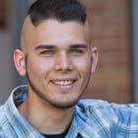

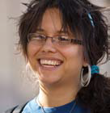


Slide 2
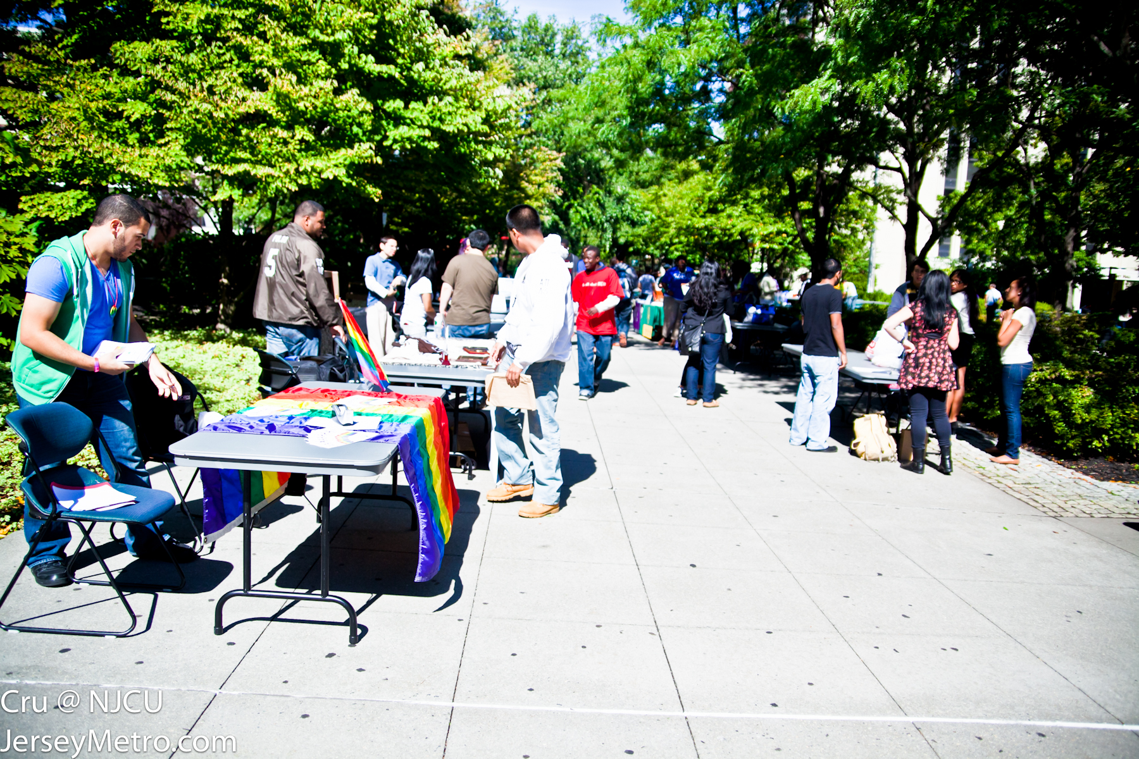
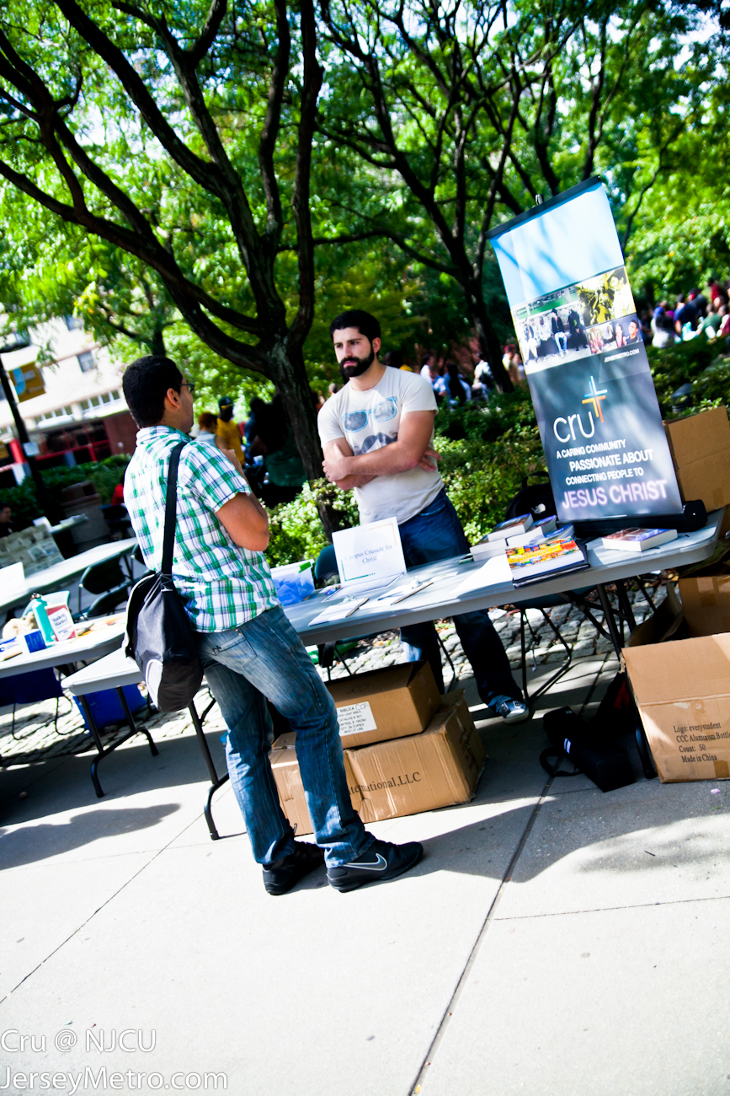
Cru Campus Crusade for Christ
COMPETITION
There is tremendous competition for the minds and hearts of students.

Slide 3


Cru Campus Crusade for Christ
STUDENTS TODAY FACE MANY CHALLENGES
“Forget everything you learned about the New Testament. Jesus was a homosexual and a magician.”
―PHILOSOPHY PROFESSOR
SOUTHEASTERN COLLEGE
“While you are in this class, you will be expected to be an Agnostic or Atheist. Anyone with sincere religious beliefs will be expected to take off his religious hat”
― PROFFESSOR, UNIVERSITY OF TEXAS
A recent study by a task force on college drinking indicated that the following number of alcohol-related incidents occur each year among students in the U.S.: Nearly 600,000 injuries; 6,000 sexual assaults, more than 1,800 deaths.
“My youngest son is attending the University of Oklahoma…[He] has been thoroughly brainwashed by his professors. He has lost his faith in God and has been taught that truth is relative.”
― LETTER FROM A GRIEVED MOTHER TO CRU

Slide 4
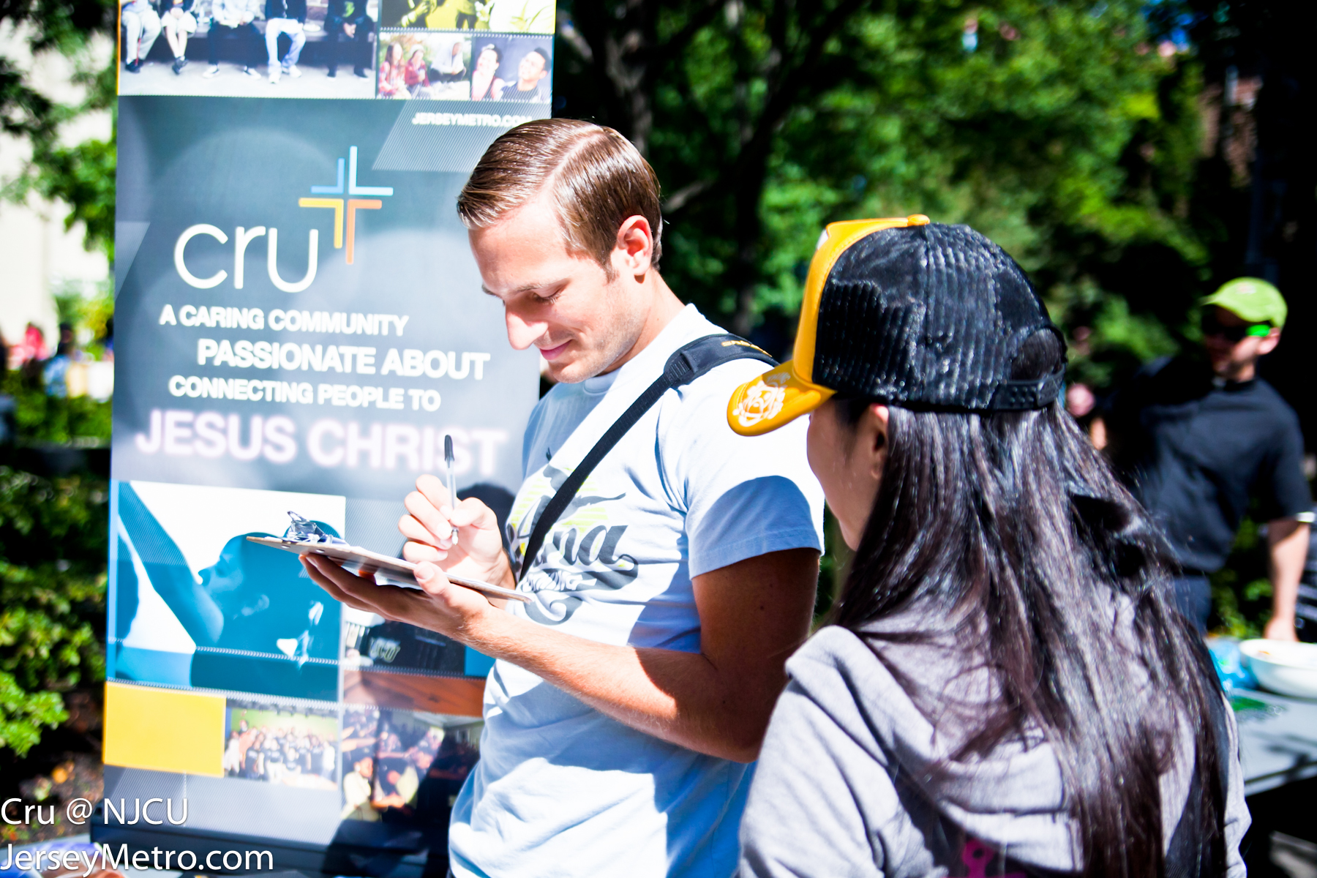
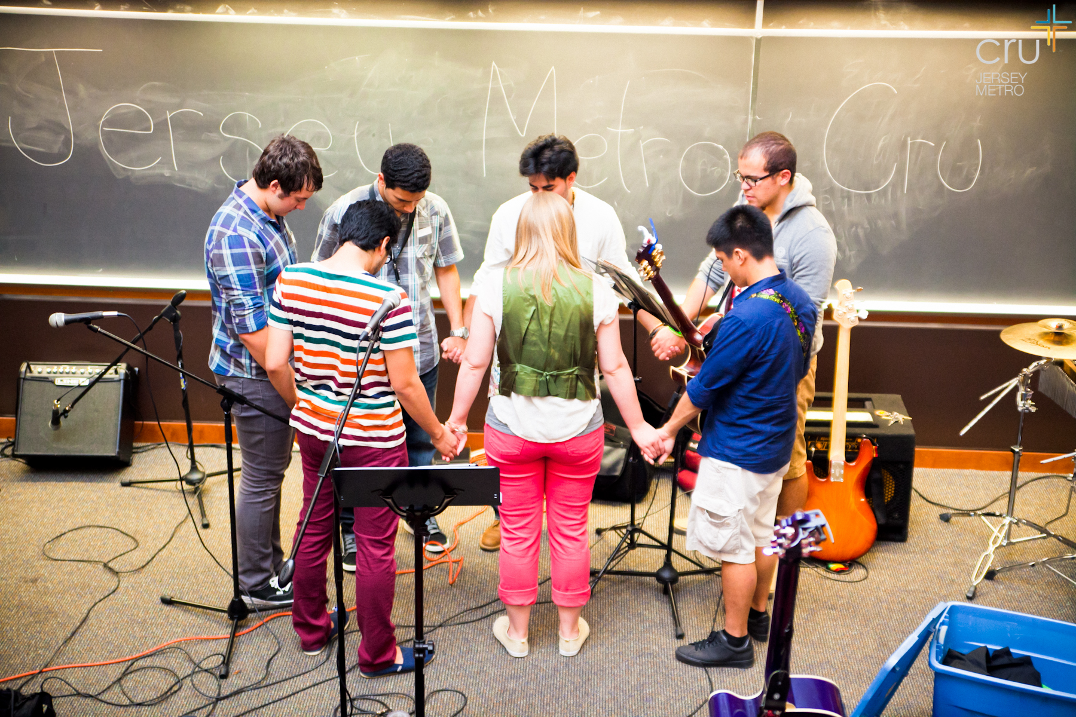

Cru Campus Crusade for Christ
BUT GOD
In the face of these competitive forces, God is bringing an increasing number of students into a relationship with Himself.

Slide 5
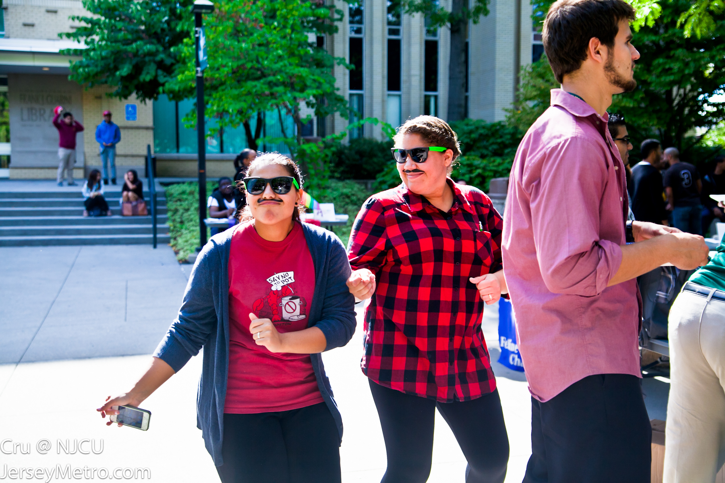
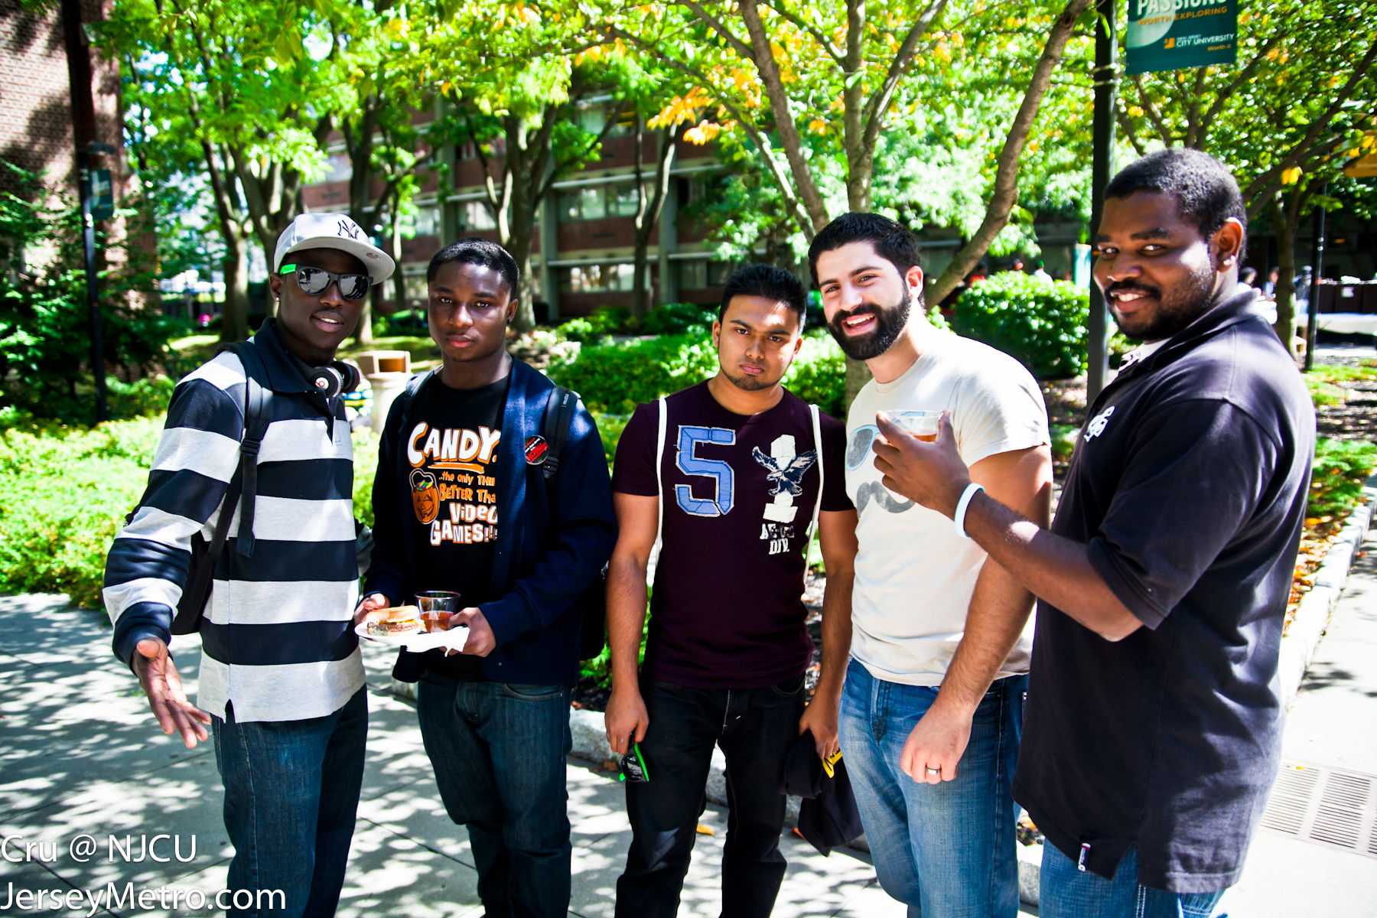
Cru Campus Crusade for Christ
EACH STUDENT
We are trusting God to reach the 150 million college students of the world with the message of Christ. Each student. Every campus.

Slide 6
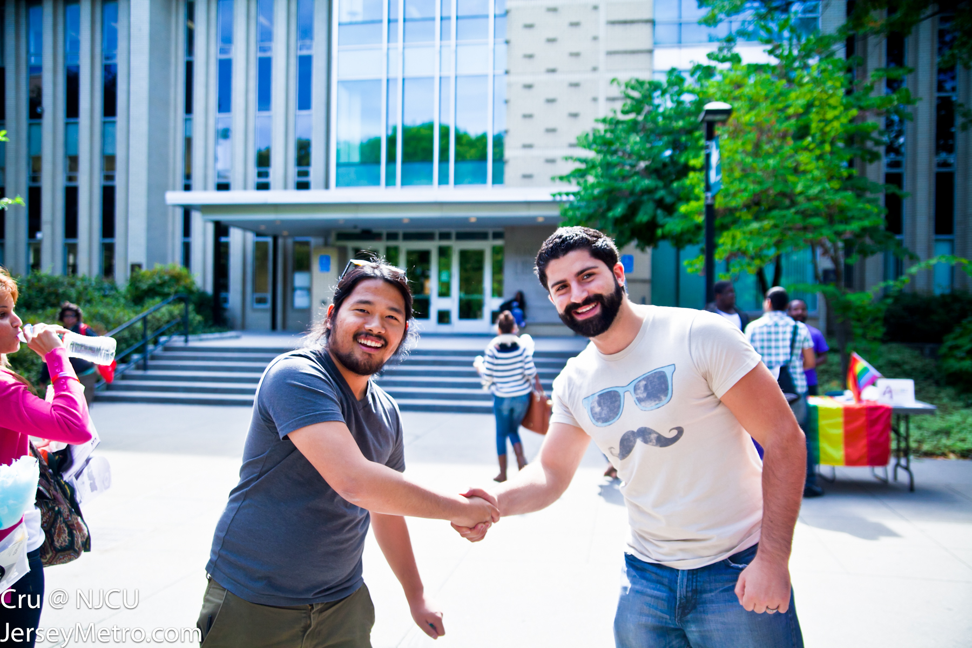

Cru Campus Crusade for Christ
We talk with students about Christ in many ways.
» Conversations
» Outreaches
» Digital and Social Media
WIN
INTRODUCING PEOPLE TO JESUS

Slide 7
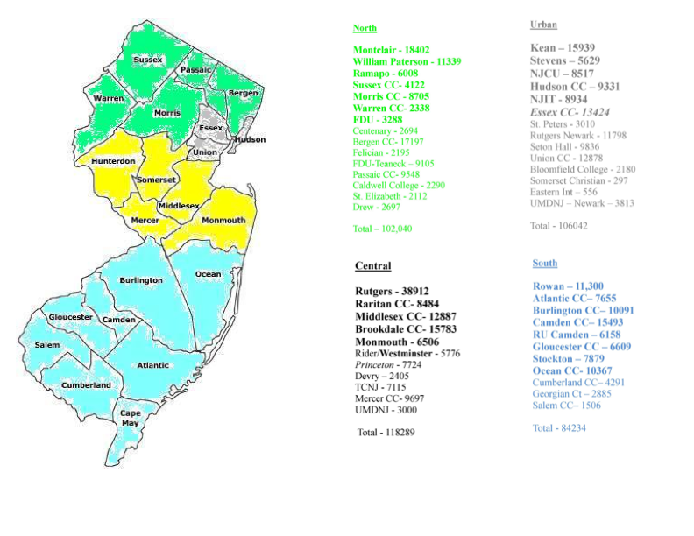

Slide 8
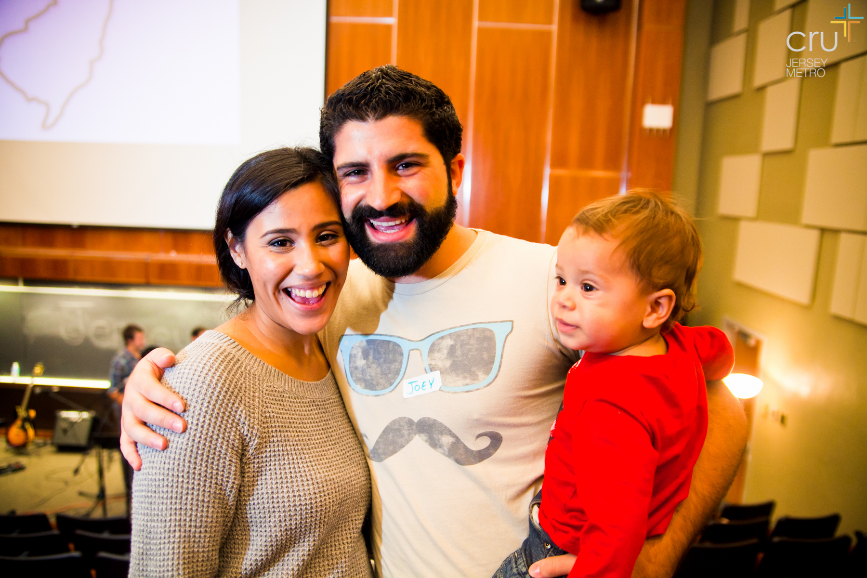
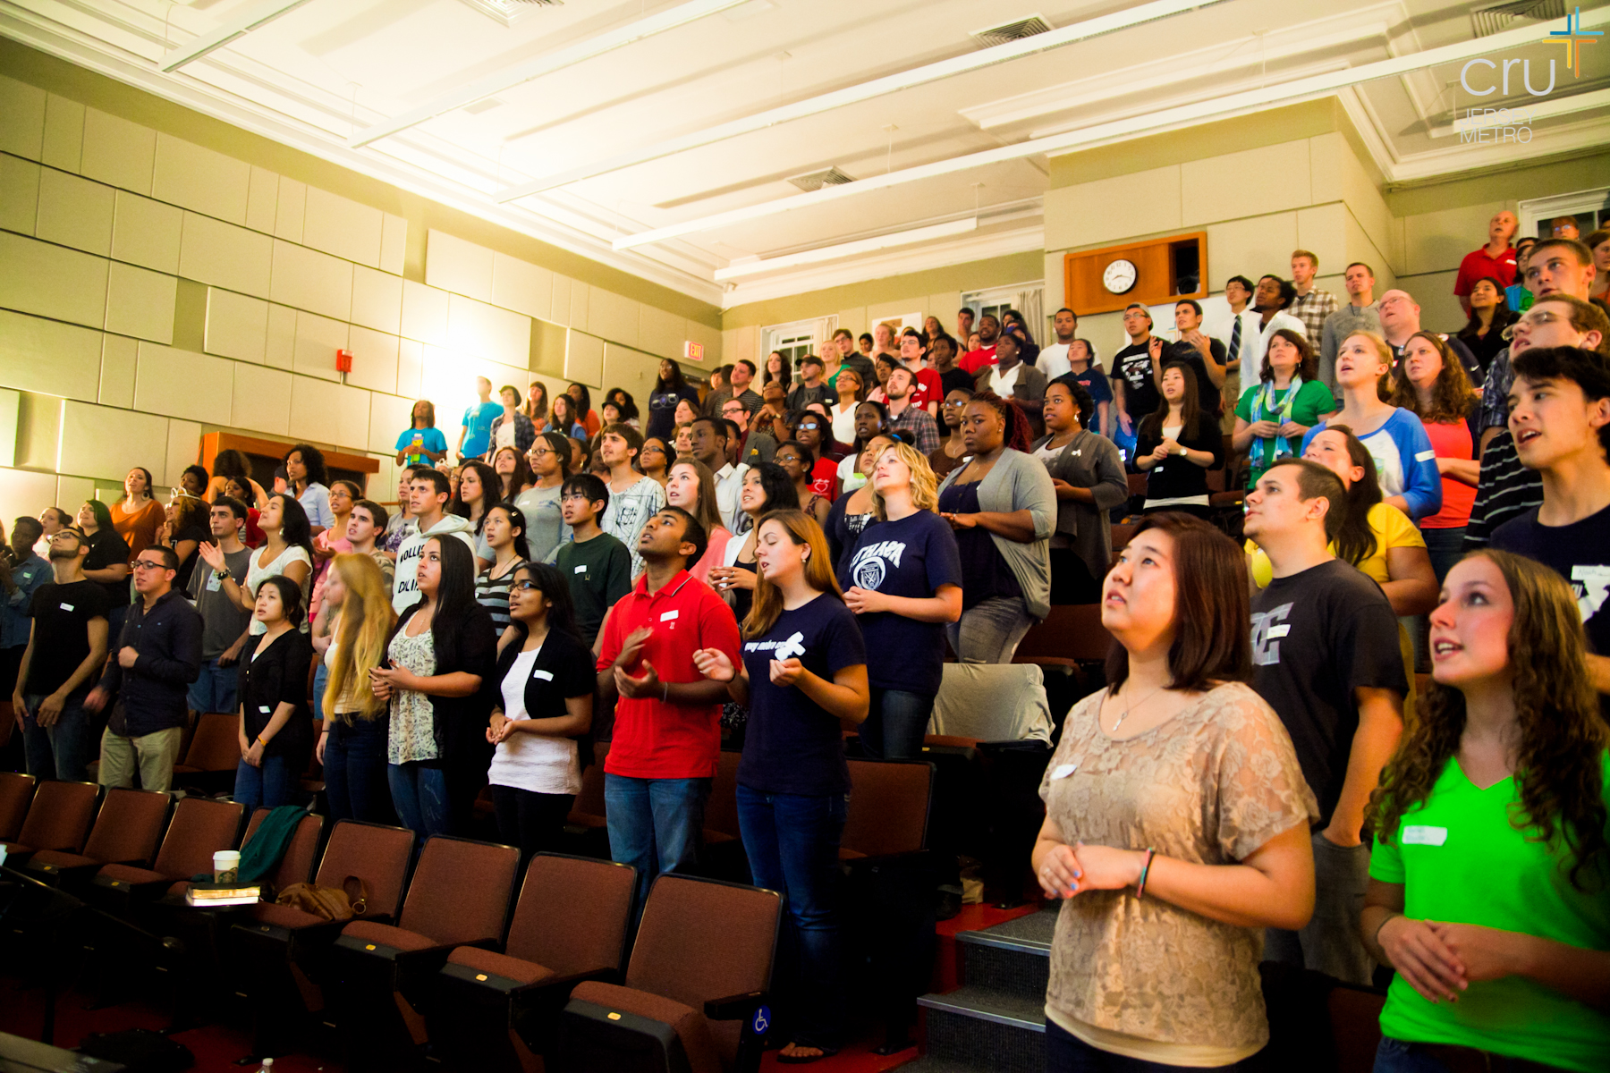
Cru Campus Crusade for Christ
BUILD
CREATING
LIFE-CHANGING COMMUNITY
Our ministry is about changed lives.

Slide 9
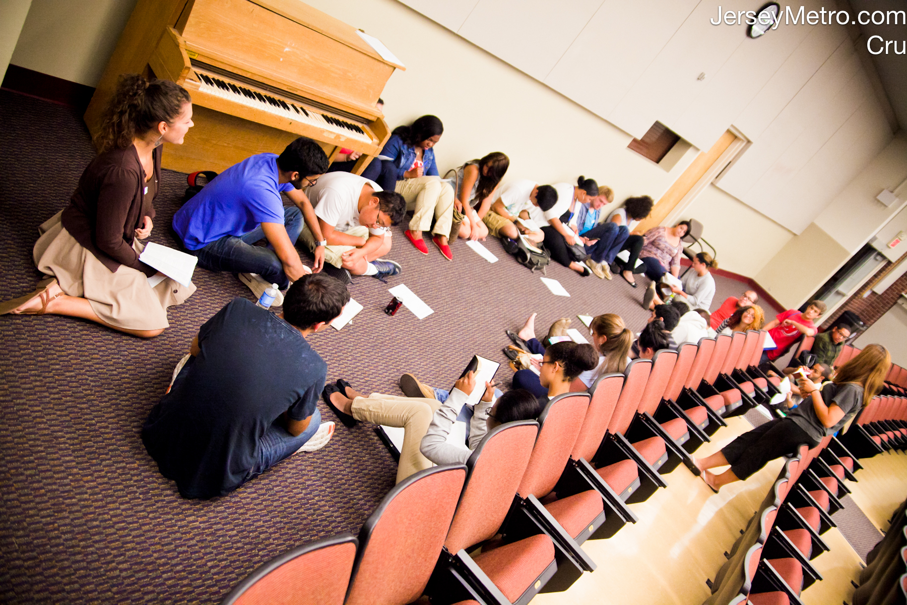
Cru Campus Crusade for Christ
BUILD
CREATING
LIFE-CHANGING COMMUNITY
We help students grow in their relationship with God through:
» Conferences and retreats
» Small groups
» Mentoring relationships
» Learning how to tell others about Christ

Slide 10


Cru Campus Crusade for Christ
SEND
» Short-term and long-term
mission trips
» Church leadership
» Ministry in the workplace
» Full-time Christian work
LIVING LIFE ON A MISSION

Slide 11

Cru Campus Crusade for Christ
SEND
100% SENT
From the university campus a great missionary force is being raised up and sent out to reach the world for Christ.
“As the Father has sent me,
I am sending you.”
-- JESUS (JOHN 20:21)

Slide 12

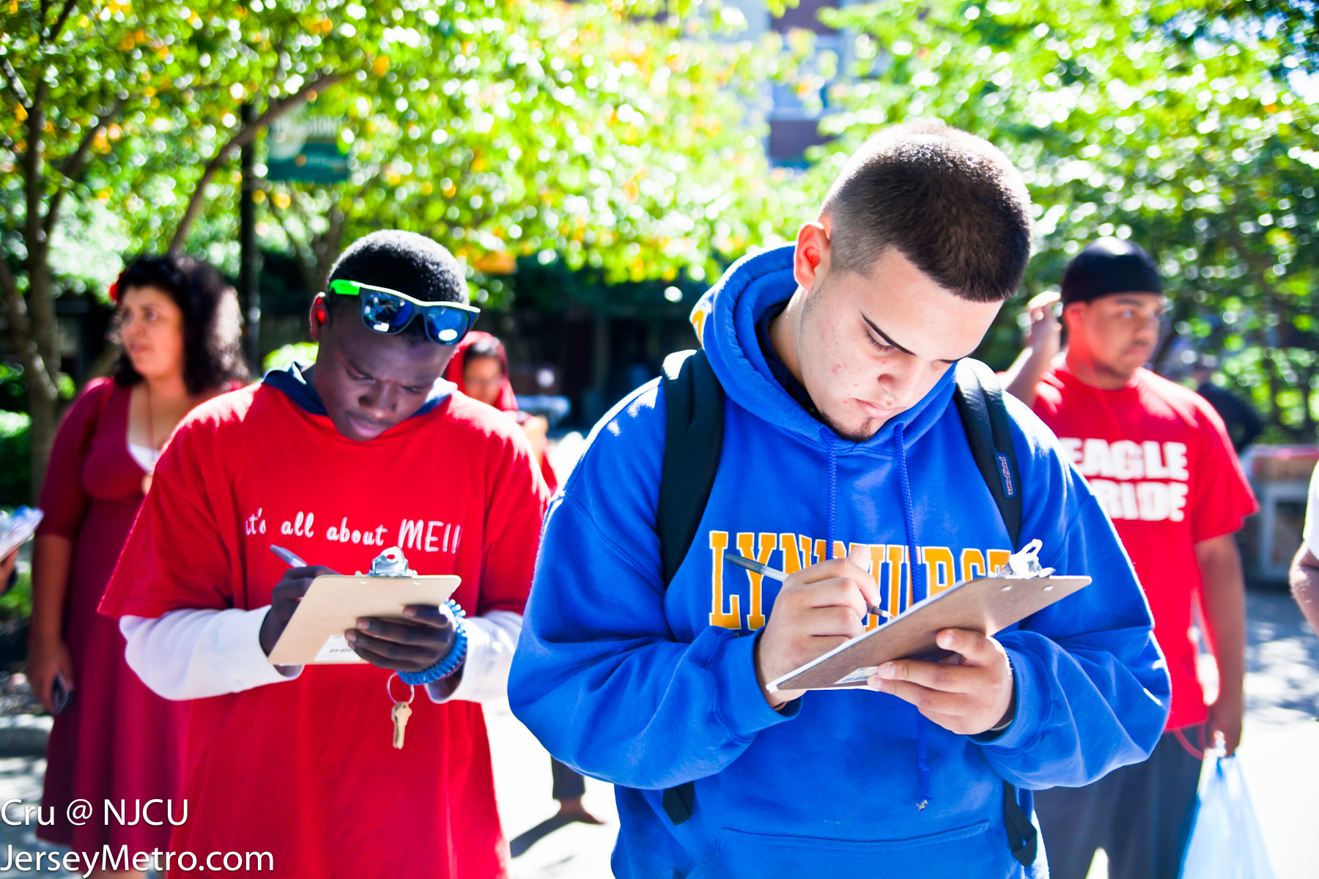
Cru Campus Crusade for Christ
OUR
SPECIFIC
ROLE
As part of the Jersey Metro team, we’re reaching 400,000 students. Cru is on 30 campuses of the 60 in NJ.

Slide 13
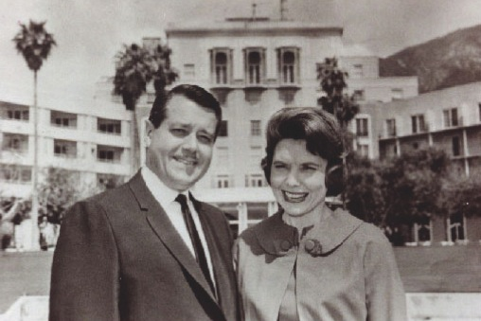
Cru Campus Crusade for Christ
OUR PAST
This is the couple who started Cru on the UCLA campus in 1951 – Bill and Vonette Bright.

Slide 14

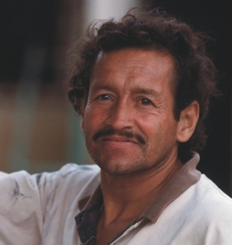
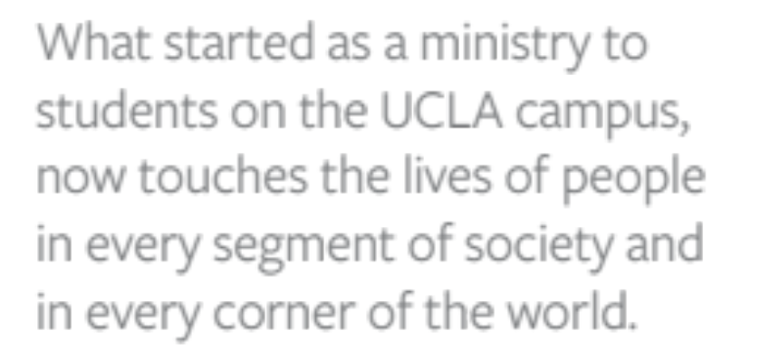
Cru Campus Crusade for Christ

Slide 15


Cru Campus Crusade for Christ
OUR PRESENT
» André Kole Ministry
» Athletes in Action
» Christian Embassy D.C.
» Christian Embassy U.N.
» Faculty Commons
» Family Life
» Global Aid Network (GAIN)
» Great Commission Foundation
» Here’s Life Inner City
» The Impact Movement
(A partnering ministry)
» The JESUS Film Project
» Josh McDowell Ministry
» Keynote
» Military Ministry
» New Life Resources
» Priority Associates
» Story Runners
» Student Venture
» U.S. Campus Ministry
» Bridges International
» Destino Movement
» Epic Movement
» Nations Movement
» World Headquarters at Lake Hart

Slide 16
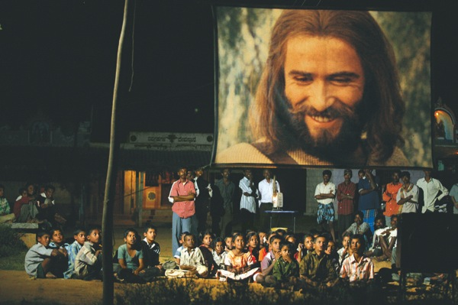

Cru Campus Crusade for Christ
» Cru is the name of Campus Crusade for Christ in
the United States.
» We are a caring community passionate about
connecting people to Jesus Christ.
» Our objective is for every person in the world to
have an opportunity to hear the Gospel.
OUR PAST, PRESENT AND FUTURE

Slide 17


Cru Campus Crusade for Christ
We invite others to partner with us to reach people for Christ.

Slide 18

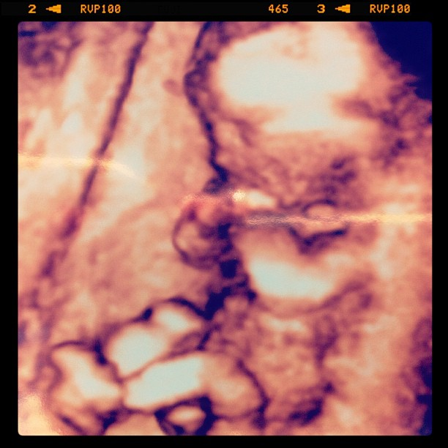
Cru Campus Crusade for Christ
Cru has no central funds for paying salaries and ministry expenses.
Like many other mission organizations, Cru depends upon the consistent financial support of concerned individuals and churches.
These contributions are used to fund the ministries of our staff members.

Slide 19



Cru Campus Crusade for Christ
We must find a team of partners who will give $100 monthly or some other amount to support our ministry.
As soon as this team is complete, we can turn our full attention to reaching people for Christ.

Slide 20

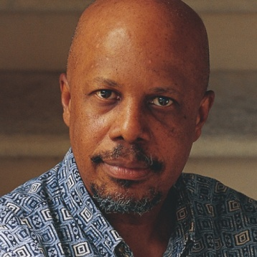


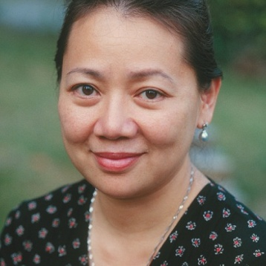


Cru Campus Crusade for Christ
MY
COMMITMENT
TO MY PARTNERS
» To work diligently to touch the lives of people
for Jesus Christ.
» To regularly let you know how God is
blessing the ministry.
» To be financially faithful with the funds given
for my ministry.
» To share prayer concerns with one another.

Slide 21
Cru Campus Crusade for Christ
OUR
COMMITMENT
TO MY PARTNERS
» To work diligently to touch the lives of people
for Jesus Christ.
» To regularly let you know how God is
blessing the ministry.
» To be financially faithful with the funds given
for our ministry.
» To share prayer concerns with one another.

Slide 22




Cru Campus Crusade for Christ
THE
COMMITMENT
Your partnership can make a difference in reaching people for Christ.
Would you make a monthly commitment of $100 or some other amount?

Slide 23
Cru Campus Crusade for Christ
There’s another vital way you can help…

